Slide 1
The world of music

Slide 2
Jazz
Classical music
Blues
Rock music
Rap
Country music
Opera
Pop music
Rock’ n roll
Dance music
Traditional folk music
Reggae

Slide 3
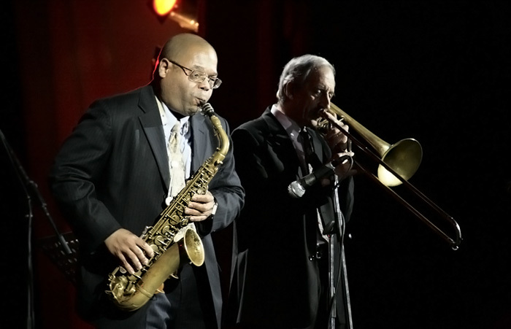



Slide 4
Answer key
1 doesn’t say
2 doesn’t say
3 true
4 doesn’t say
5 false

